Slide 1
A new location for your business
Giving you the most similar and low crime area possible.

Slide 2
Data Acquisition and Cleaning
Crime data provided by the city of Los Angeles: https://data.lacity.org/A-Safe-City/Crime-Data-from-2010-to-2019/63jg-8b9z
Geographical data provided by USC: https://usc.data.socrata.com/dataset/Los-Angeles-Neighborhood-Map/r8qd-yxsr
Crimes that were given with no location dropped.
Only necessary columns kept.

Slide 3
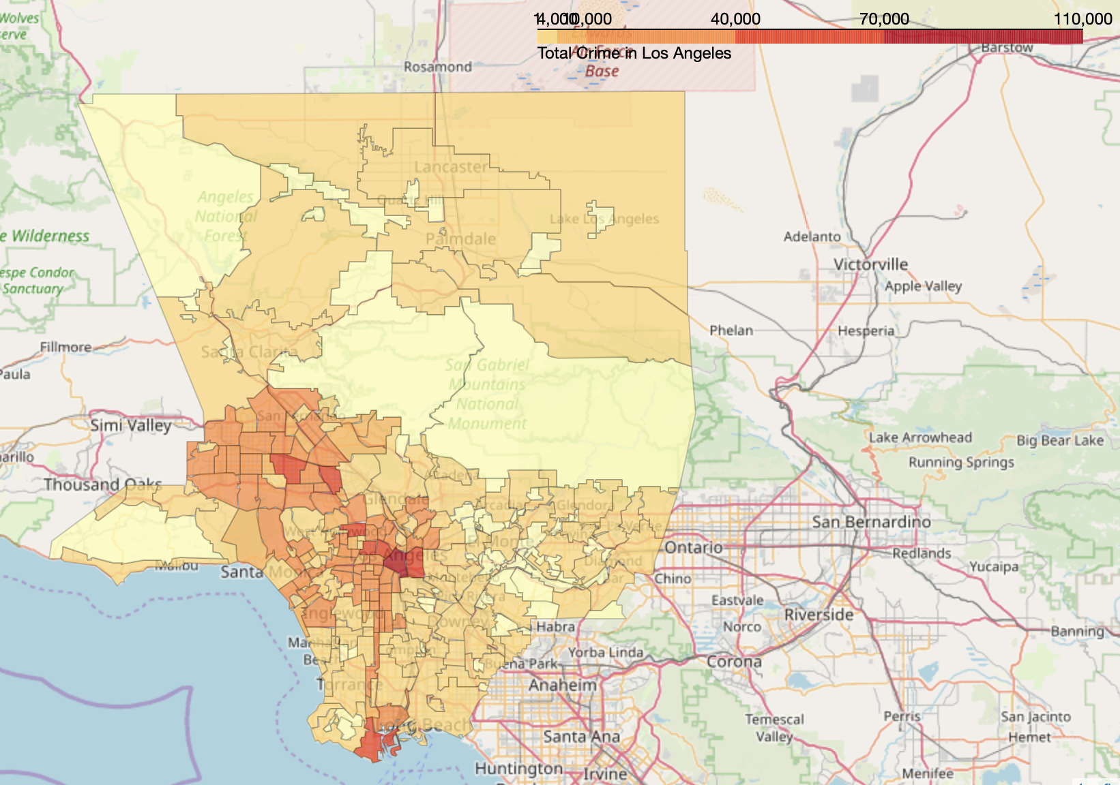
Visualising Total Crime

Slide 4
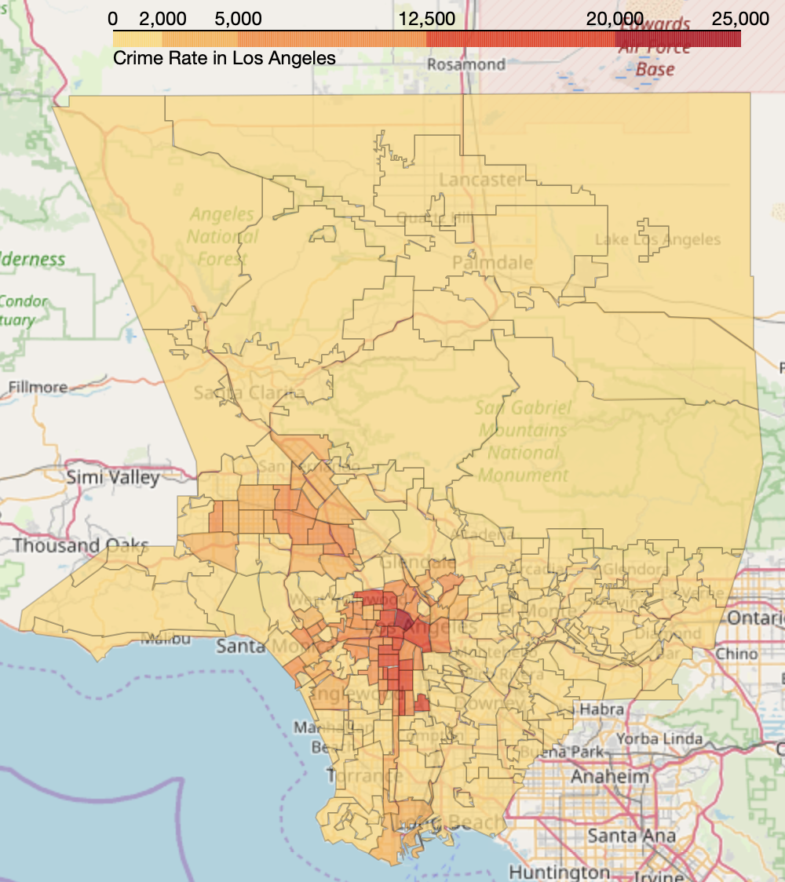
Visualising Crime per Square Mile

Slide 5
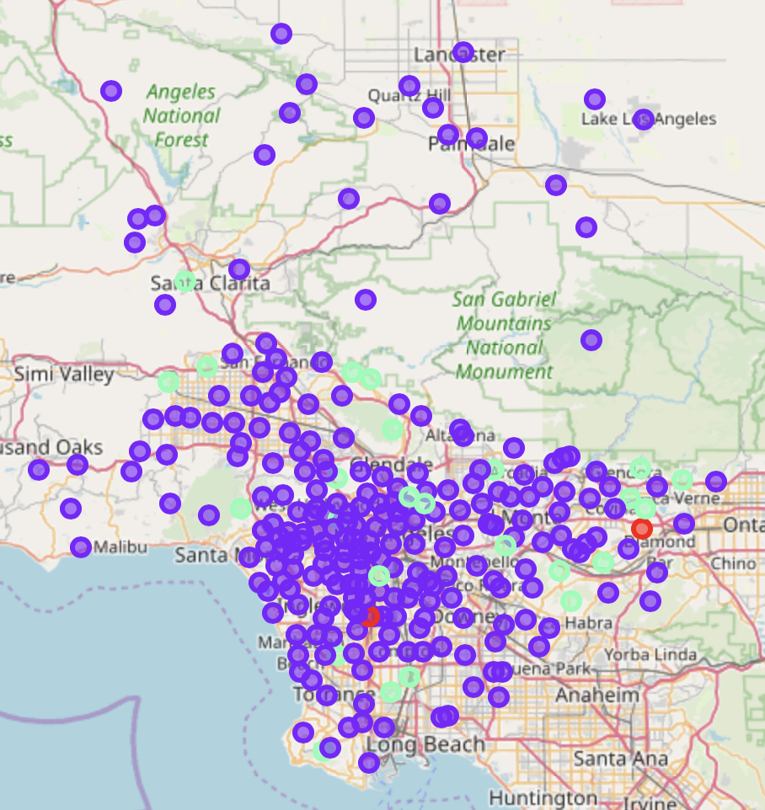
Grouping Neighborhoods by Similar Features
Foursquare API used to group neighborhoods by the similarity of venues.

Slide 6
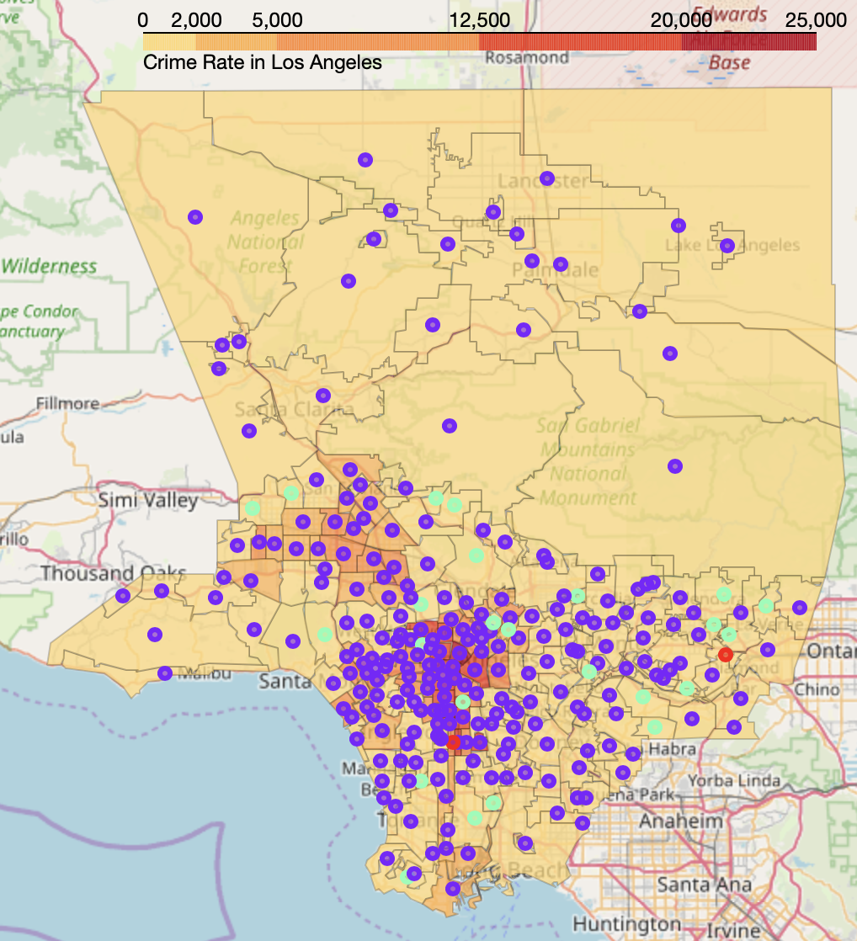
Overlaying the Neighborhood Clusters on the Crime per Square Mile Choropleth Map

Slide 7
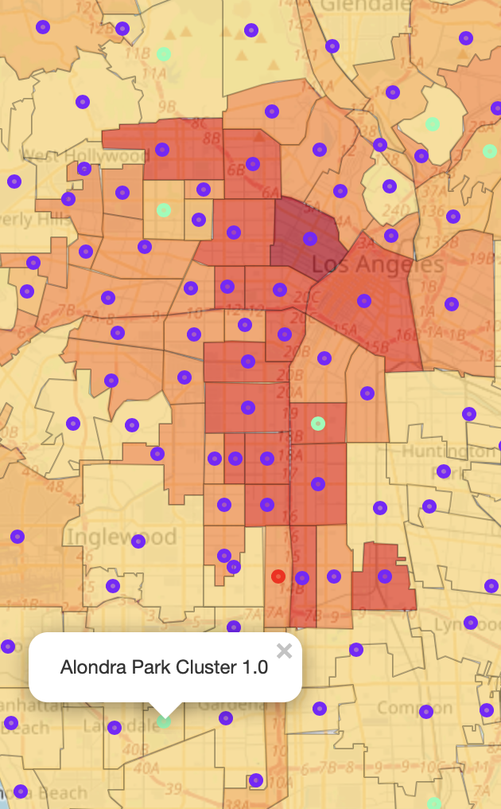
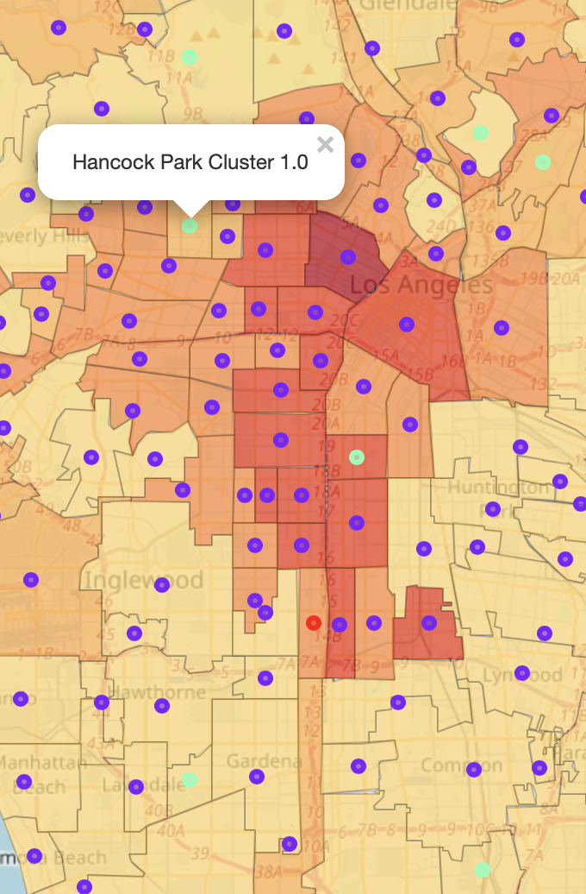
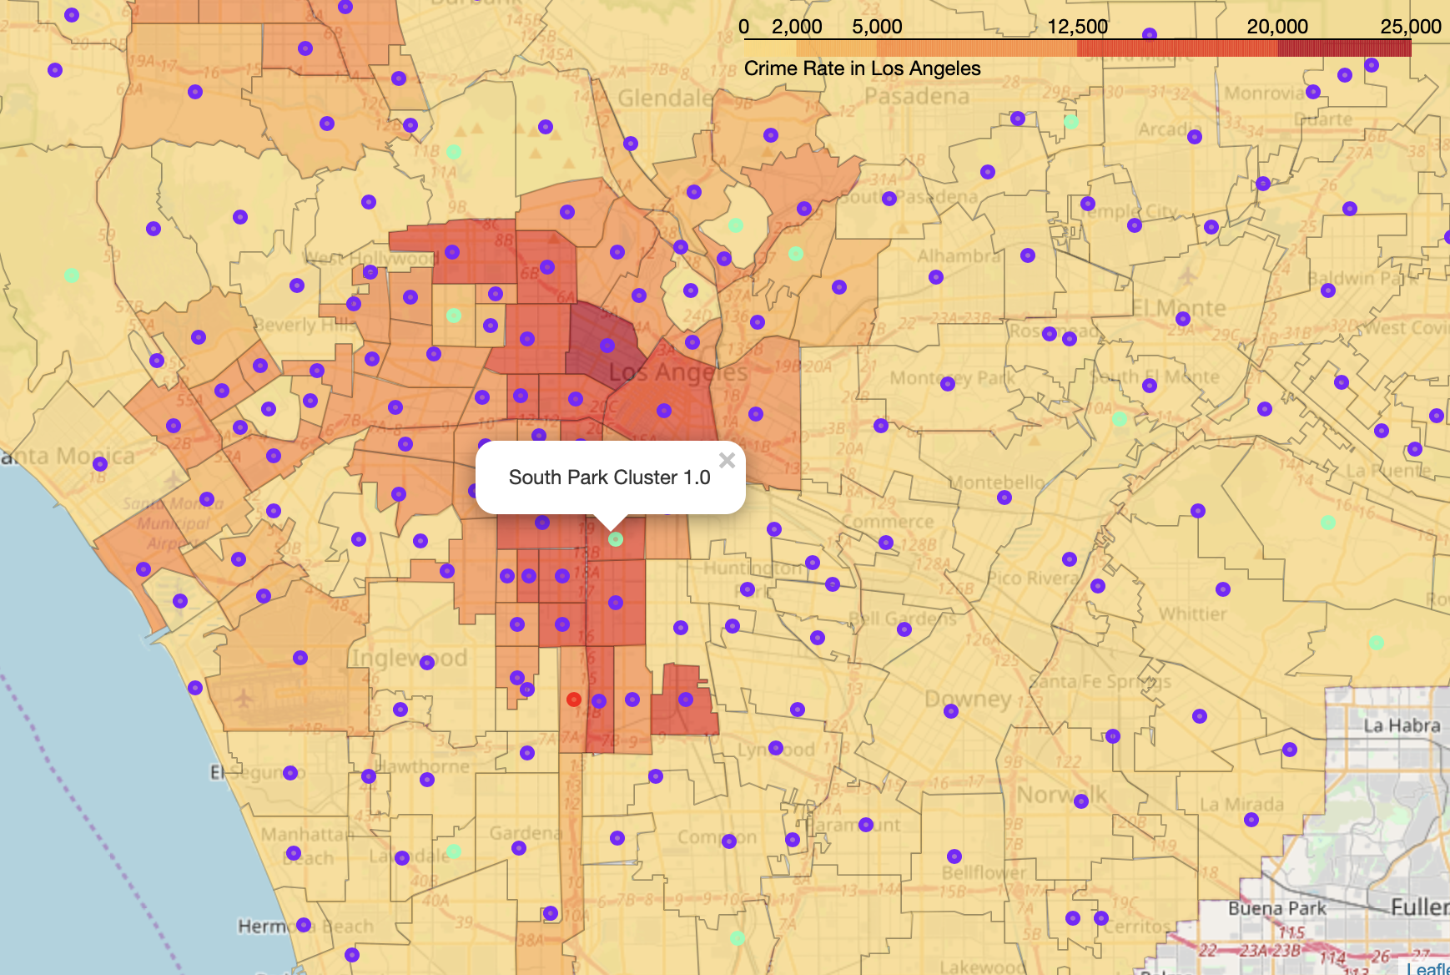
Neighborhood Suggestions
Current Neighborhood
Suggestion 1
Suggestion 2

Slide 8
Conclusion and Improvements
Possible improvements include factoring more variables into the suggestion process like rent prices, proximity and competition.
My suggestion would be to open the second branch in Hancock park due to its relatively low crime, proximity to the city’s center and similarity to South park, the current neighborhood.

